Slide 1


OutRAN : Co-optimizing for Flow Completion Time in Radio Access Network
Jaehong Kim, Yunheon Lee, Hwijoon Lim, Youngmok Jung, Song Min Kim, Dongsu Han
Notes:
Hi, I’m Jaehong Kim, a 3rd year Ph.D student at KAIST.
In this talk, I will introduce our work called OutRAN,
which is a new scheduler that applies the concept of Flow Completion Time (FCT) to the cellular network.

Slide 2









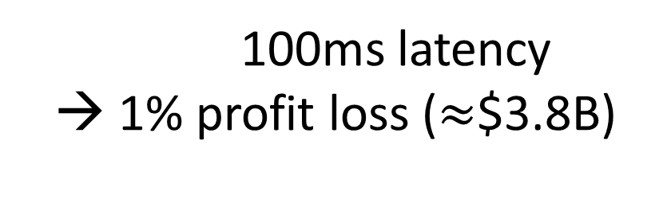
Interactive applications demand low latency.
100ms latency → 1% profit loss ($≈$$3.8B)
Request (Uplink)
Radio link
(LTE/5G)
Response (Downlink)
Remote Host

Slide 3







QoS provisioning defined in the standard
The 3GPP defines multiple QoS classes with different priorities based on latency-sensitivity.
High
Latency-sensitivity
Low
Conversational
RT Streaming
Interactive
Background

Slide 4
QoS provisioning in current Cellular Networks
High
Latency-sensitivity
Low
Conversational
RT Streaming
Interactive
Background
Dedicated QoS
(Guaranteed Bit Rate)
Best-effort

Slide 5

QoS provisioning in current Cellular Networks
Interactive traffic shares the same quality of service with the background traffic.
Radio
Internet
User
xNodeB
4G/5G Core
Remote Hosts
Dedicated QoS (GBR)
Interactive
& Background
Best-effort (Non-GBR)

Slide 6
Problem of the existing base station scheduling
When short flows of the Interactive applications
co-exist with large background flows,
Downlink
Best-effort
Large
Short
User
xNodeB
Remote Host

Slide 7
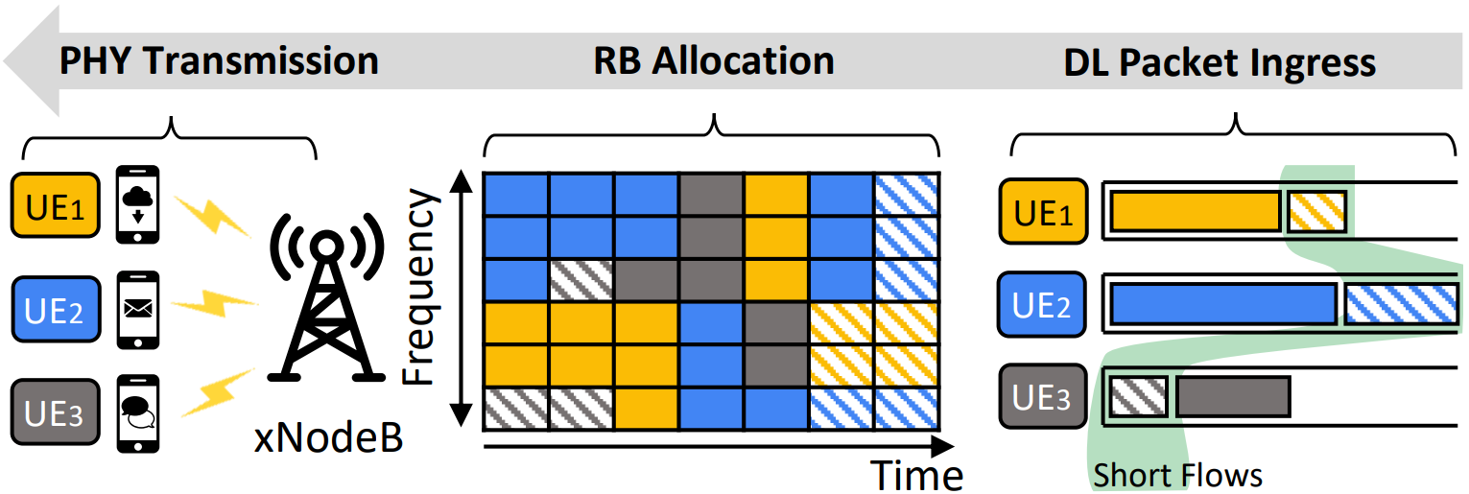
Problem of the existing base station scheduling
Latency-sensitive short flows could experience severe queueing delay.
Queueing Delay
Tx Complete

Slide 8
Key enablers of achieving low latency in 5G
1. Edgification of Servers and Core Networks ➔ Reduces latency in backhaul
2. New Radio (NR) Interface ➔ Brings low-latency in-air
Internet
UE
5G NR
gNodeB
MEC
Remote Hosts
Air latency
Trasnport Latency

Slide 9

The problem becomes significant in 5G.
Queueing delay at the base station still remains a problem in effectively reducing the end-to-end latency.
Queueing delay
Internet
UE
5G NR
gNodeB
MEC
Remote Hosts
Air latency
Trasnport Latency

Slide 10
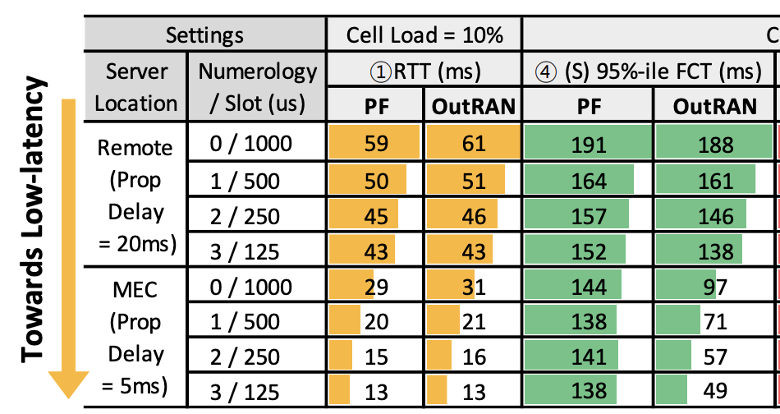
Preview: Impact of OutRAN in 5G
Queueing delay prevents short flows from fully utilizing 5G's low latency.
Cell Load = 60%
51% by MEC
28%
74%
27% by NR

Slide 11
Cause #1: Large buffers in base stations
Base stations use large buffers (>10 x BDP[1,2]) for
bursty traffic, channel fluctuation, retransmissions.
Large queueing delay!
xNodeB
[1] An In-depth Study of LTE [SIGCOMM ‘13]
[2] Tackling Bufferbloat in 3G/4G Networks [IMC’12]

Slide 12
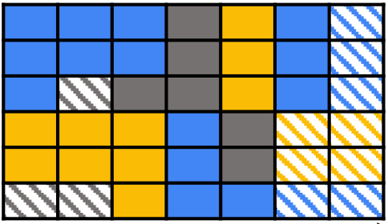
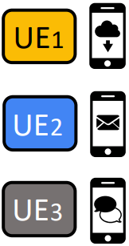
Cause #2: Service-agnostic Scheduler
Designed to balance between spectral-efficiency and user fairness. (e.g., Proportional Fair scheduler)
Channel
Quality Report
(for efficiency)
Frequency
xNodeB
Time
Scheduler
Resource Block Allocation
Average throughput
(for fairness)
Buffer Status Report

Slide 13
Problem of the existing base station scheduling
Latency-sensitive short flows could experience severe queueing delay.
Queueing Delay
Tx Complete

Slide 14
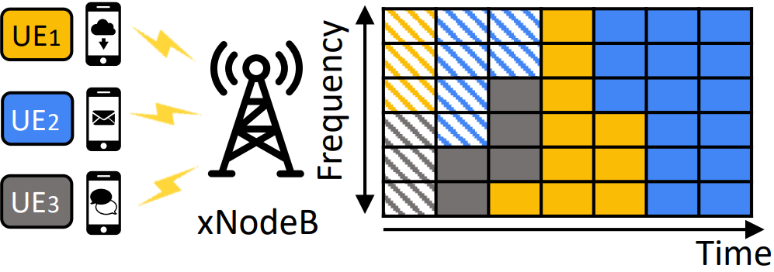
Flow scheduling can achieve better latency
by completing latency-sensitive short flows first
➔ minimize Flow Completion Time (FCT)
Complete Short Flows First!

Slide 15
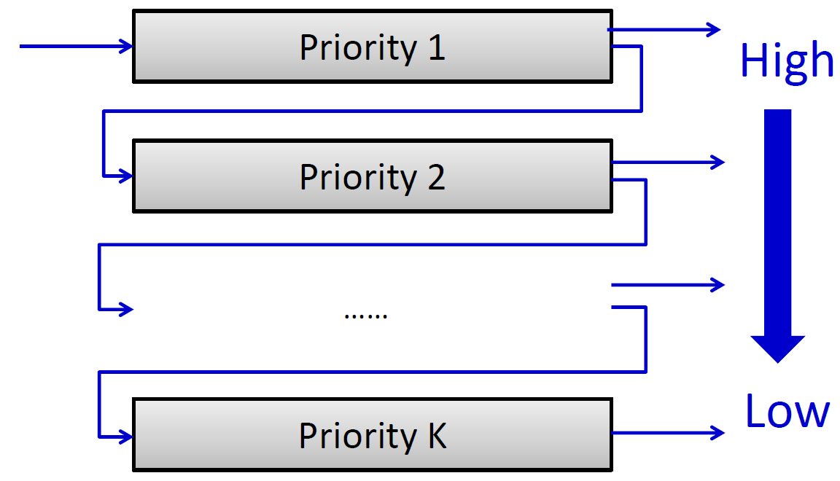
Opportunity: Information-agnostic scheduling
Multiple-level Feedback Queue (MLFQ) [3,4,5] can
emulate Shortest Job First (SJF) without information.
[3] PIAS [NSDI’15]
[4] Aalo [SIGCOMM’15]
[5] AuTO [SIGCOMM’18]
Image credit: PIAS [3]

Slide 16


Opportunity: Information-agnostic scheduling
Multiple-level Feedback Queue (MLFQ) [3,4,5] can
emulate Shortest Job First (SJF) without information.
10MB
10MB
High
Low
Threshold (20KB)
20KB
[3] PIAS [NSDI’15]
[4] Aalo [SIGCOMM’15]
[5] AuTO [SIGCOMM’18]
Image credit: PIAS [3]

Slide 17
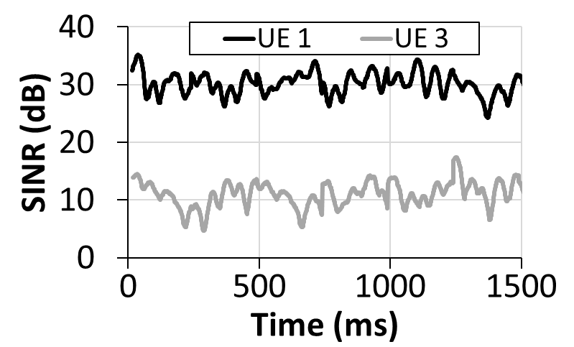
Unique characteristics in Cellular Networks
Far
Close
UE 3
UE 1
Different geographical locations and mobility
Users experience different channel quality across time.

Slide 18
Case of applying the naive information-agnostic flow scheduling
Results in different scheduling decision from the legacy cellular scheduler.
Best Channel
Quality
UE1
Poor
UE2
Best
Shortest
Flow
UE 3
UE3
UE 1
Short Flows

Slide 19
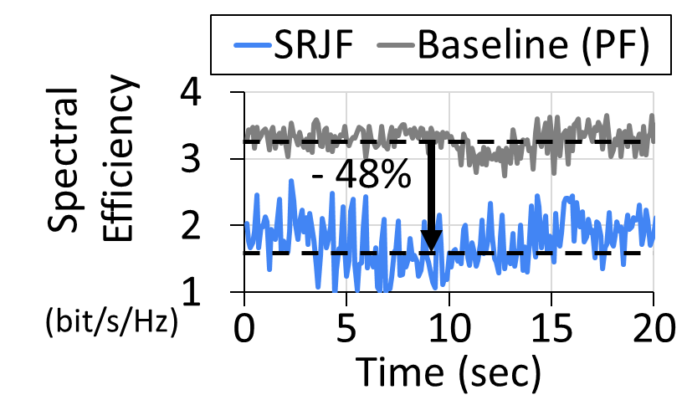
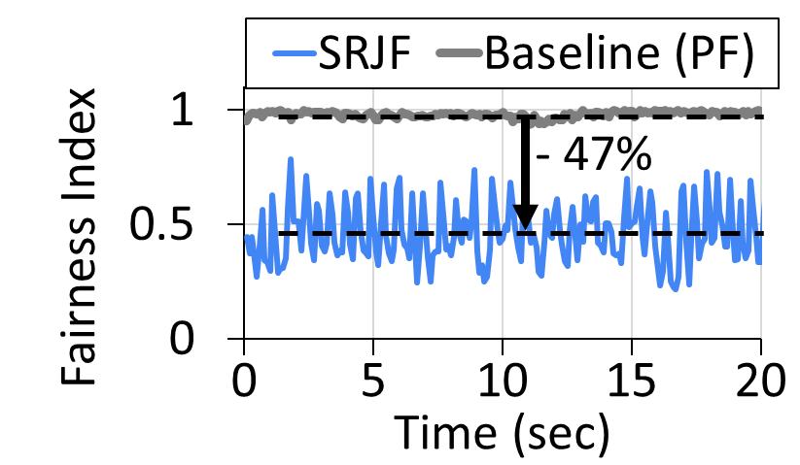
Side-effect of the naive approach
Hurts the spectral efficiency and user fairness.
To get benefit, we need to tailor flow scheduling
for radio access network.

Slide 20
Scope & Goal of OutRAN
Target: downlink best-effort user traffic
Scope: downlink scheduling at the last-mile base station
Goal: co-optimize the Flow Completion Time (FCT) and key cellular scheduler metrics (e.g., spectral efficiency)
Best-effort, QoS Unavailable
Buffer
xNodeB
Remote Server
Flow Scheduling

Slide 21
Challenge: Mismatch in optimization goals
Cellular network schedulers have different optimization goal;
ex) maximizing the radio resource utilization (or fairness).
Active Users
Ours
Legacy
User having
Shortest flow
User with the Best channel quality

Slide 22
Challenge: How can we satisfy both goals?
Key idea: find the user-flows that best balance for both optimization goals.
Active Users
Excellent Channel Quality
Short Flows
OutRAN
Shortest Flow
Best Channel

Slide 23
Design #1: Intra-user Flow Scheduler
Effectively improves the FCT without any loss of the
legacy scheduler metrics.
Active Users
Short Flows
Shortest Flow
Best Channel

Slide 24
Design #1: Intra-user Flow Scheduler
Emulate SJF on the flows sharing the same user
(i.e., intra-user flows) using MLFQ.
Packet scheduling
UE1
MLFQ Scheduling
UE1
UE2
UE2
UE3
UE3
Short Flows
Short Flows

Slide 25
Design rationale
We can switch between Intra-user Flows and maintain
the exact same spectral efficiency and user fairness.
Packet scheduling
Selected
UE1
Selected
UE1
UE2
UE2
UE3
UE3
Short Flows
Short Flows
: Packet scheduling
: Radio Resource Block scheduling

Slide 26
Design rationale
Even if we don’t pick the shortest flow,
choosing any user-flow always improves the FCT.
Improvement
UE1
UE1
Best Channel
Quality
Best Channel
Quality
UE2
UE2
UE3
UE3
Short Flows
Short Flows
: Queueing delay by large flow

Slide 27
Design #1: Intra-user Flow Scheduler
Effectively improves the FCT without any loss of the
legacy scheduler metrics.
Improvement
Active Users
Short Flows
UE1
Best Channel
Quality
UE2
Shortest Flow
UE3
Best Channel
Short Flows

Slide 28
Design #2: Inter-user Flow Scheduler
Effectively improves the FCT imposing minimal impact on the legacy scheduler metrics.
Active Users
Excellent Channel Quality
Short Flows
Shortest Flow
Best Channel

Slide 29
Exploring more opportunity
Exploit the case where users are experiencing a
similar channel quality (or per Resource Block metric).
Poor
Excellent
UE 1
UE 1
Best
Best
UE 2
UE 2
Heterogenous Users
Homogeneous Users

Slide 30
Design #2: Inter-user Flow Scheduler
Opportunistically prioritizes the user carrying
short flow among the homogenous user set if there’s any.
Packet scheduling
Excellent Channel
Quality
Excellent
UE1
UE2
UE 1
Best
UE3
Short Flows
UE 2
Homogeneous Users

Slide 31
Design #2: Inter-user Flow Scheduler
Opportunistically prioritizes the user carrying
short flow among the homogenous user set if there’s any.
Selected
Excellent
UE1
Excellent
UE2
UE 1
UE3
Best
Short Flows
UE 2
Homogeneous Users
: Packet scheduling
: Radio Resource Block scheduling

Slide 32
Design #2: Inter-user Flow Scheduler
If we cannot find the homogenous users,
select the best one just like the original scheduler.
UE1
Poor
Best Channel
Quality
UE2
UE 1
UE3
Best
Short Flows
UE 2
Heterogenous Users

Slide 33
Design #2: Inter-user Flow Scheduler
Instead of strictly selecting the user having the “best” per Resource Block metric (e.g., Channel Quality), expand the room by |ε|.
Active Users
Excellent Channel Quality
Short Flows
|ε|
Shortest Flow
Best Channel

Slide 34
Integrating OutRAN into xNodeB
OutRAN also considers unique design aspects in xNodeB.
L3
IP
Header compression
Sequence numbering
Cipherying
PDCP
L2
RLC
Segmentation & reassembly
Retransmission
xNodeB Radio Protocol Stack
MAC
Scheduling
Retransmission
L1
PHY

Slide 35


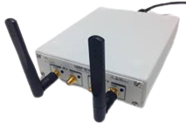
Implementation and Overview
Implemented on top of the srsRAN, open-source LTE/5G software radio suite.
Flow identification
PDCP
Linux Machine
Flow state management
L2
RLC
Intra-user Flow Scheduler
MAC
Inter-user Flow Scheduler
L1
PHY
USRP B210

Slide 36
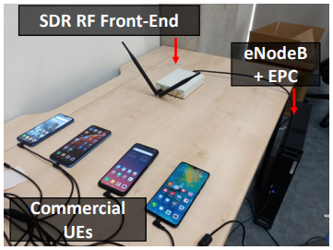

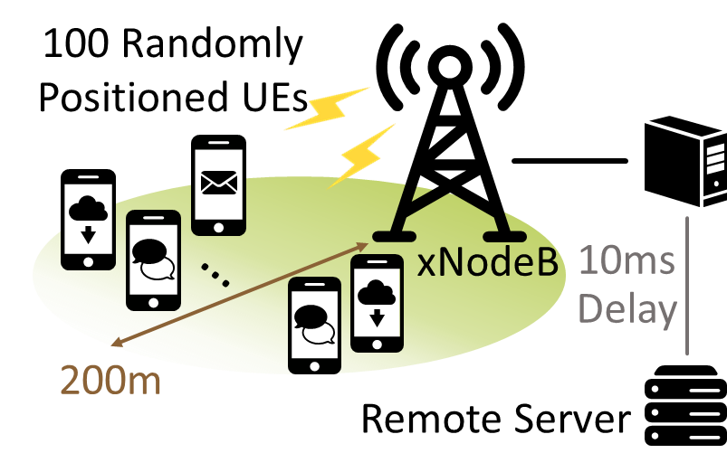
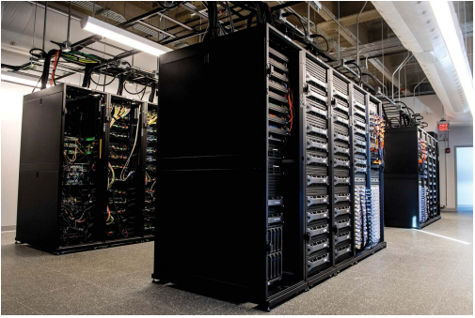
Evaluation Platforms
We evaluate OuRAN using a combination of testbed experiments and NS-3 simulations:
1. Over-the-air testbed
2. Colosseum wireless emulator
3. Cell scale NS-3 simulations

Slide 37
Evaluation Platforms
1. Over-the-air testbed
2. Colosseum wireless emulator
3. Cell scale NS-3 simulations
Mobile application
Realistic RF scenarios [6]
Large-scale of users,
Advanced 5G settings
[6] SCOPE [MobiSys’21]

Slide 38
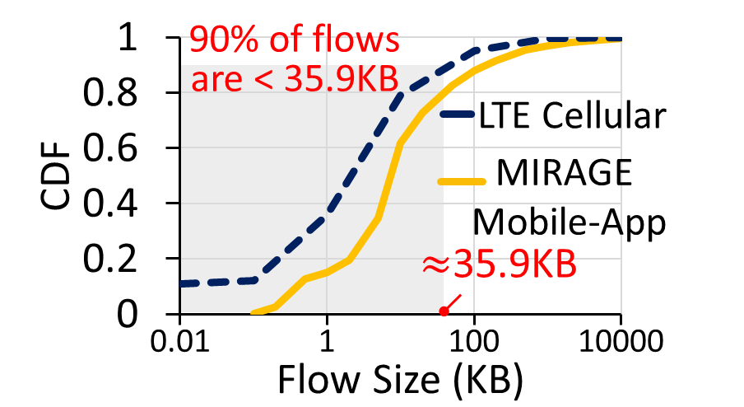
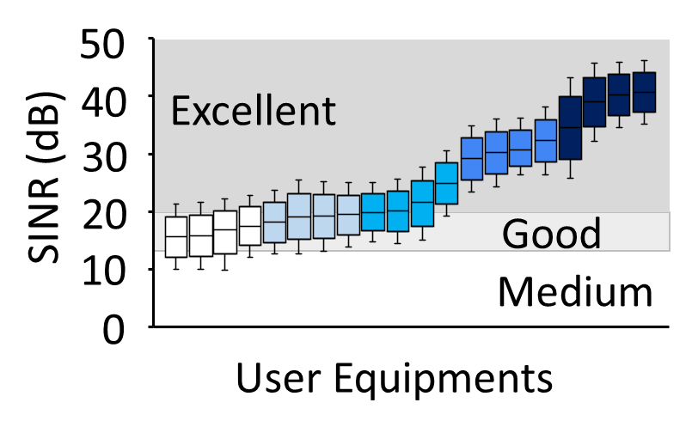
Evaluation Setup
Traffic distribution : downlink cellular traffic dist collected in realworld eNodeBs [1]
Channel dynamics: 3GPP pedestrian scenario
Baselines : Proportional Fair (PF), SRJF, QoS-aware (CQA, PSS)
Metrics: Page load time (PLT) and FCT
Channel quality distribution
Downlink cellular traffic distribution [1]
[1] An In-depth Study of LTE [SIGCOMM ‘13]

Slide 39
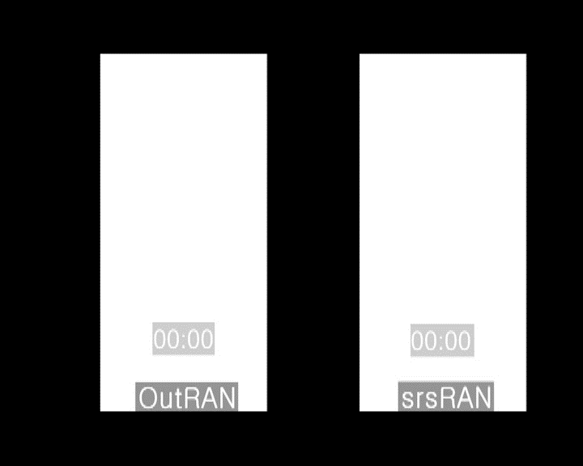
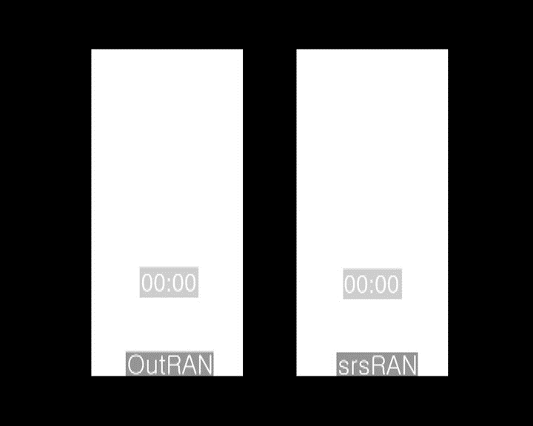
PLT Improvement
OutRAN shows an average 14% (up to 34%) reduction in PLT for the top 20 webpages from Alexa.

Slide 40
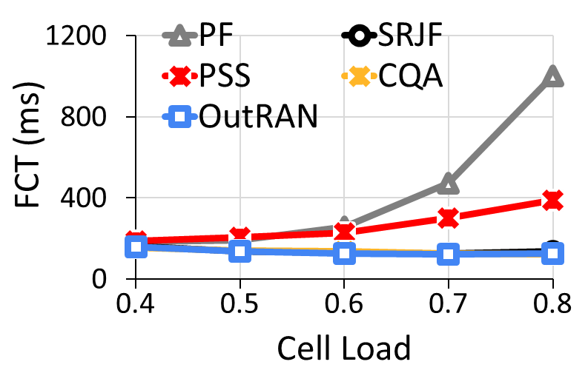
FCT Improvement: Short Flow FCT
OutRAN shows comparable short flow FCT to that of the SRJF and QoS-aware schedulers.
OutRAN works well without prior information.
de-facto standard
Better
QoS-aware
Short Flow (< 10KB) 95%-ile

Slide 41
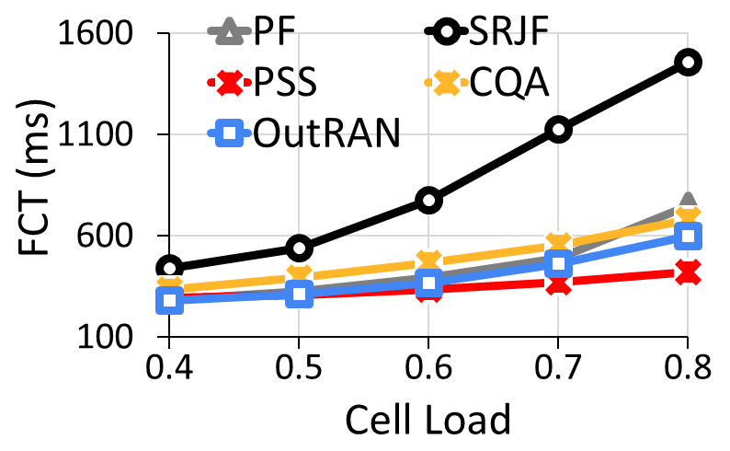
What about Long Flow FCT?
Unlike SRJF, OutRAN considers both spectral efficiency and flow size. It does not starve long flows.
Better
Worst due to channel-unaware scheduling
Long Flow (> 0.1MB) FCT

Slide 42
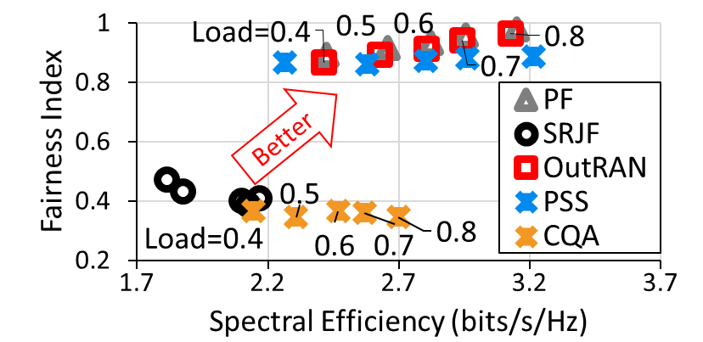
Spectral-efficiency and user fairness
OutRAN preserves 98% and 97% of spectral efficiency and fairness respectively that PF provides.

Slide 43
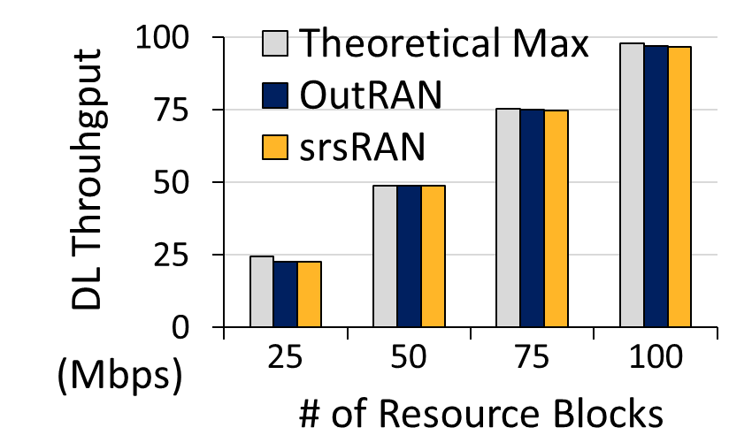
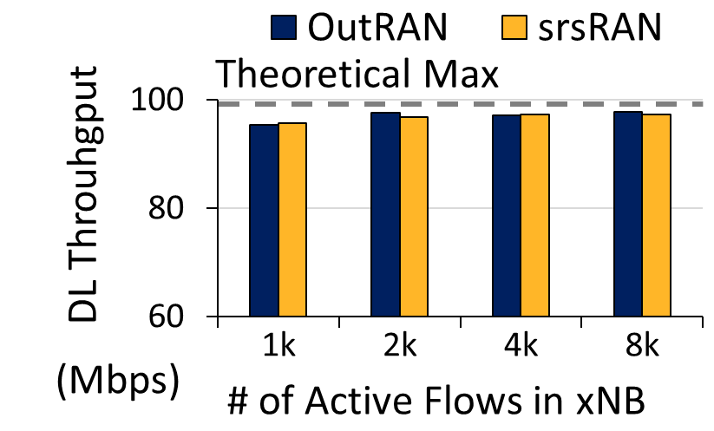
Scalability
OutRAN has the same computational complexity as the original scheduler. It can scale and handle large number of flows.

Slide 44
Impact of OutRAN in 5G
OutRAN is compatible with 5G NR, provides greater improvement in short flow FCT when utilized together.
1ms
Numerology 0
15kHz
Scheduling resolution
Low-latency in air
500us
Numerology 1
30kHz
250us
Numerology 2
60kHz
125us
Better
Numerology 3
120kHz

Slide 45
Conclusion
OutRAN demonstrates the feasibility of co-optimizing the FCT in cellular networks.
It achieves better latency for interactive application by scheduling its short flows first at the last-mile base station.
It is practical; it does not require prior QoS information and respects the legacy cellular metrics.
https://ina.kaist.ac.kr/projects/outran/

Slide 46
Thank you Questions ?

